Slide 1
April 2021 Regional Team Briefing Unified Tiering Model
[Region]

Slide 2
Team Briefing Purpose
1
We’re aware of and informed about national and regional change from the Probation Reform, Probation Workforce and Recovery Programmes
2
Our opportunity to discuss how these changes might affect our team and any actions we might need to take to align with and support these changes
3
Clarify our region’s and team’s areas of focus for this month – what are our big deliverables?

Slide 3
Why Tiering Data is Important
Tiering data:
Tiering is how the NPS allocates staff resource to different types of cases
Tiering data informs the target staffing levels that we need to manage current and future organisational, team and individual caseloads, particularly how caseloads are weighted; it also provides the data underpinning caseload decisions
This means that tiering data impacts all current and future people on probation sentence management services
Additionally, tiering data informs case allocation decisions and is linked to our Workload Measurement Tool (WMT) to measure and compare staff workloads
Workload Measurement Tool Staff FAQ
Workload Measurement Tool Staff Guidance

Slide 4
What is the Unified Tiering Model?
The Unified Tiering Model calculates each individual person on probation’s level of risk and need
It combines available nDelius and OASys data and calibrates each people on probation’s tier, supporting the Target Operating Model of the Probation Reform Programme and mixed caseloads incorporating high, medium and low risk, including standalone unpaid work
The Unified Tiering Model also reflects our refreshed operating models for sentence management, resettlement and women’s services, in line with our new organisation’s operating model and culture
Developed by our Digital, Data & Technology team to support our new unified model

Slide 5
Unified Tiering Model
Reflecting the Probation Reform Programme’s designs for the Unified Model, it is proposed that tiering is revised to reflect Risk of Serious Harm (RoSH) and need
Change (Need) | High | 3
 | Medium | 2
 | Low | 1
 |  | 0
 |  |  | D | C | B | A
 |  |  | Low | Medium | High | Very High
 |  |  | Assess & Protect (Risk of Serious Harm)
Dynamic to reflect workload at start of sentence / release
Reflecting change work sought for low public protection
Adaptive to changes in circumstance
Reflect no change remit from court for standalone unpaid work with domestic violence

Slide 6
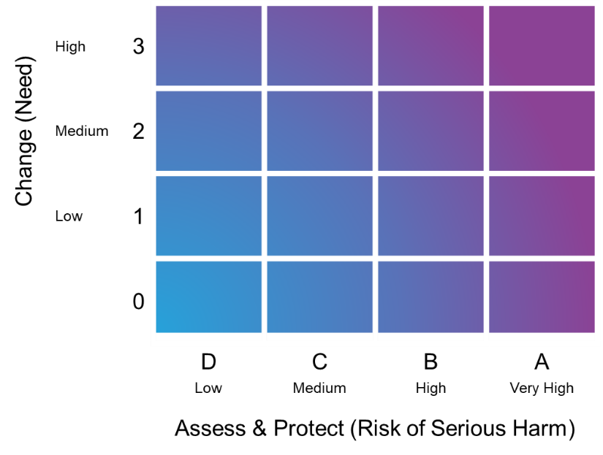
Unified Tiering Model Scoring Principles
Points based thresholds which broadly line up with the current NPS interim tiering model, supporting alignment with the offender management in custody (OMiC) model
A points based system to support future flexibility, rather than a system based on fixed rules
No Tier A cases in our current interim tiering model should be lower than Tier A cases in our Unified Tiering Model
Tiering is fully automated and changes automatically when a tiering event happens, continually reflecting a people on probation’s changing circumstances

Slide 7
Unified Tiering Model Benefits
Staff benefits
Staff will benefit from a fully utilised tiering framework that allocates cases to the right probation practitioner with the right skills and experience at the right time, to support each individual person on probation with a digital application that supports resource prioritisation and allocation and reflects workload implications at the start of sentence and release
The Unified Tiering Model is also an enabler of sentence management design to improve sentence management, which benefits staff in terms of risk management and change work
The Unified Tiering Model will target team resources more efficiently and effectively, because it allocates resource based on the Risk of Serious Harm (RoSH) and intensity of need
People on probation benefits – our new name for service users
Thanks to the introduction of the change axis, the Unified Tiering Model will provide people on probation with specific resources that meet their particular area/s of need, supporting rehabilitative change and consistent service provision
The Unified Tiering Model, aligned with sentence management, will facilitate more focussed, planned and structured sessions with probation practitioners and more responsive, desistance based contact

Slide 8
Unified Tiering Model Rollout and Support
The Unified Tiering Model is scheduled to be deployed from 4 May 2021
Performance and Quality team/s were briefed in March 2021 to support our transition to the Unified Tiering Model
Frontline staff will receive concise guidance calculating the Unified Tiering Model; this will be distributed through:
Unified Tiering Model Staff FAQ
Unified Tiering Model Staff Guidance document
The April Regional Team Briefing; links to this deck will appear in April issues of:
Probation News
The Senior Leader’s Bulletin
One Programme Newsletter
This information will also be available in EQuiP
Probation practitioners will receive guidance on the Unified Tiering Model as part of their sentence management training material

Slide 9
Team Impacts
How might today’s Team Briefing topics affect our team?
Are we clear on our individual and team next steps and delivery?
How are we managing change? Do we need support?

Slide 10
THANK YOU

