Slide 1
In Self-Isolation? Struggling with the situation?
Your mental health and wellbeing is important during these are uncertain times and something none of us will have ever experienced, and will never want to experience again.
I have pulled together some resources to assist you in managing your mental health which I hope you find of use.

Slide 2
Please remember PAM…..
Your Employee Assistance Programme
EAP Support Line: 0800 882 4102 Available 24/7
www.pamassist.co.uk
username HMPPS
password HMPPS1

Slide 3
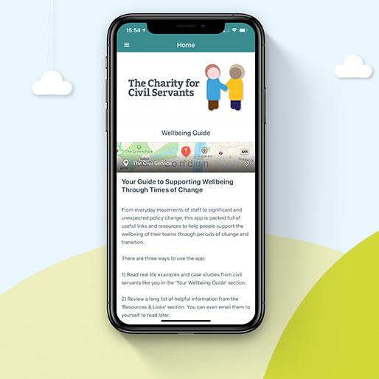
Our very own charity are there to help too…
Take a look at the website:
www.foryoubyyou.org.uk
They can help with many concerns including carers, money matters, financial assistance, wellbeing, mental health – they even have an app!

Slide 4
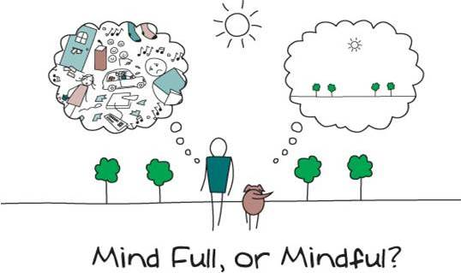
What about Mindful Breathing?
Find a relaxed, comfortable position. You could be seated on a chair or on the floor on a cushion. Keep your back upright, but not too tight. Hands resting wherever they’re comfortable. Tongue on the roof of your mouth or wherever it’s comfortable.
Notice and relax your body. Try to notice the shape of your body, its weight. Let yourself relax and become curious about your body seated here—the sensations it experiences, the touch, the connection with the floor or the chair. Relax any areas of tightness or tension. Just breathe.
Tune into your breath. Feel the natural flow of breath—in, out. You don’t need to do anything to your breath. Not long, not short, just natural. Notice where you feel your breath in your body. It might be in your abdomen. It may be in your chest or throat or in your nostrils. See if you can feel the sensations of breath, one breath at a time. When one breath ends, the next breath begins.
Now as you do this, you might notice that your mind may start to wander. You may start thinking about other things. If this happens, it is not a problem. It's very natural. Just notice that your mind has wandered. You can say “thinking” or “wandering” in your head softly. And then gently redirect your attention right back to the breathing.
Stay here for five to seven minutes. Notice your breath, in silence. From time to time, you’ll get lost in thought, then return to your breath.
After a few minutes, once again notice your body, your whole body, seated here. Let yourself relax even more deeply and then offer yourself some appreciation for doing this practice today.

Slide 5
Why not think about some mindfulness colouring? There are loads of free resources online!

Slide 6
Could you download a free Mindfulness App? These are the top 5, but there are plenty more available
Stop, Breathe & Think
Aura

Slide 7
There are charities that understand….

Slide 8
Have you had to become a teacher?....
www.educationotherwise.org
https://www.sparklebox.co.uk/parents
www.home-education.org.uk/resources-educational
www.teachmykids.co.uk
www.bbc.co.uk/bitesize
There are plenty more!
Find Out What Your Child Already Knows
Ask questions geared to your child's age level. For older kids, you might ask, "Are people in school talking about coronavirus? What are they saying?" For younger children, you could say, "Have you heard grownups talking about a new sickness that's going around?" This gives you a chance to learn how much kids know — and to find out if they're hearing the wrong information.
Follow your child's lead. Some kids may want to spend time talking. But if your kids don't seem interested or don't ask a lot of questions, that's OK.
Offer Comfort — and Honesty
Focus on helping your child feel safe, but be truthful. Don't offer more detail than your child is interested in. For example, if kids ask about school closings, address their questions. But if the topic doesn't come up, there's no need to raise it unless it happens.

Slide 9
Keep your mind active – learn something new
www.civilservicelearning.civilservice.gov.uk
www.poalearning.org.uk

Slide 10
What are we doing locally?
Social distancing as you come in
Hand sanitisers
Following government guidelines
No gym, no education, no work (except laundry and kitchen), no association, no visits
Advising staff and residents on isolation in line with guidelines
Sending out daily updates
www.gov.uk/coronavirus
www.gov.uk/government/organisations/public-health-england
www.nhs.uk/conditions/coronavirus-covid-19

